Slide 1
Bus Imbalance
L. Burke
11/7/17

Slide 2
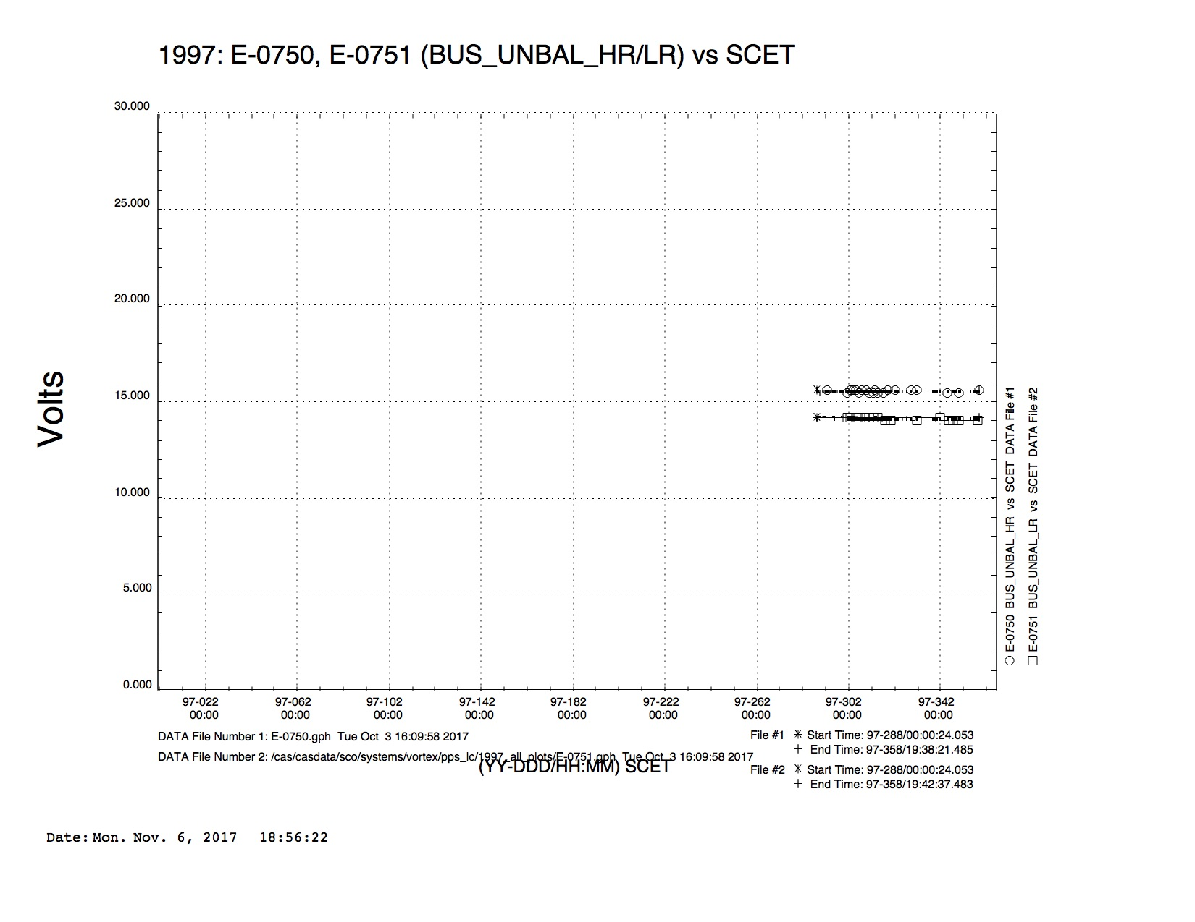
1997

Slide 3
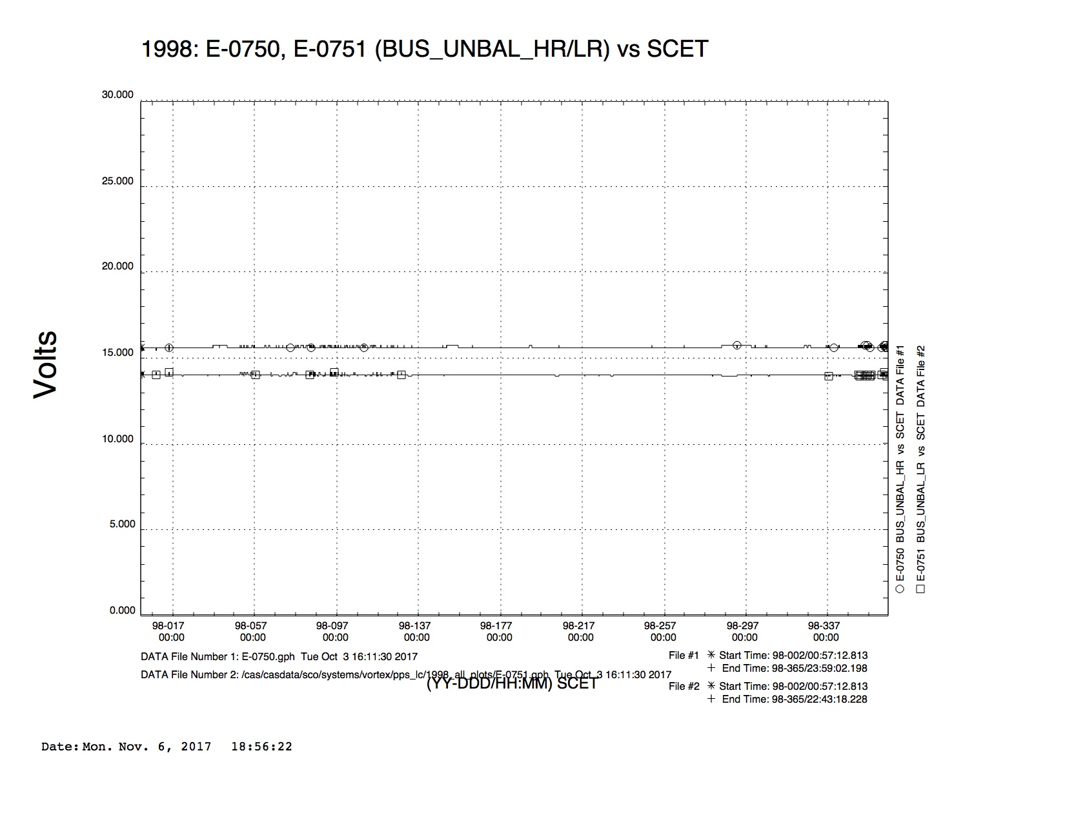
1998

Slide 4
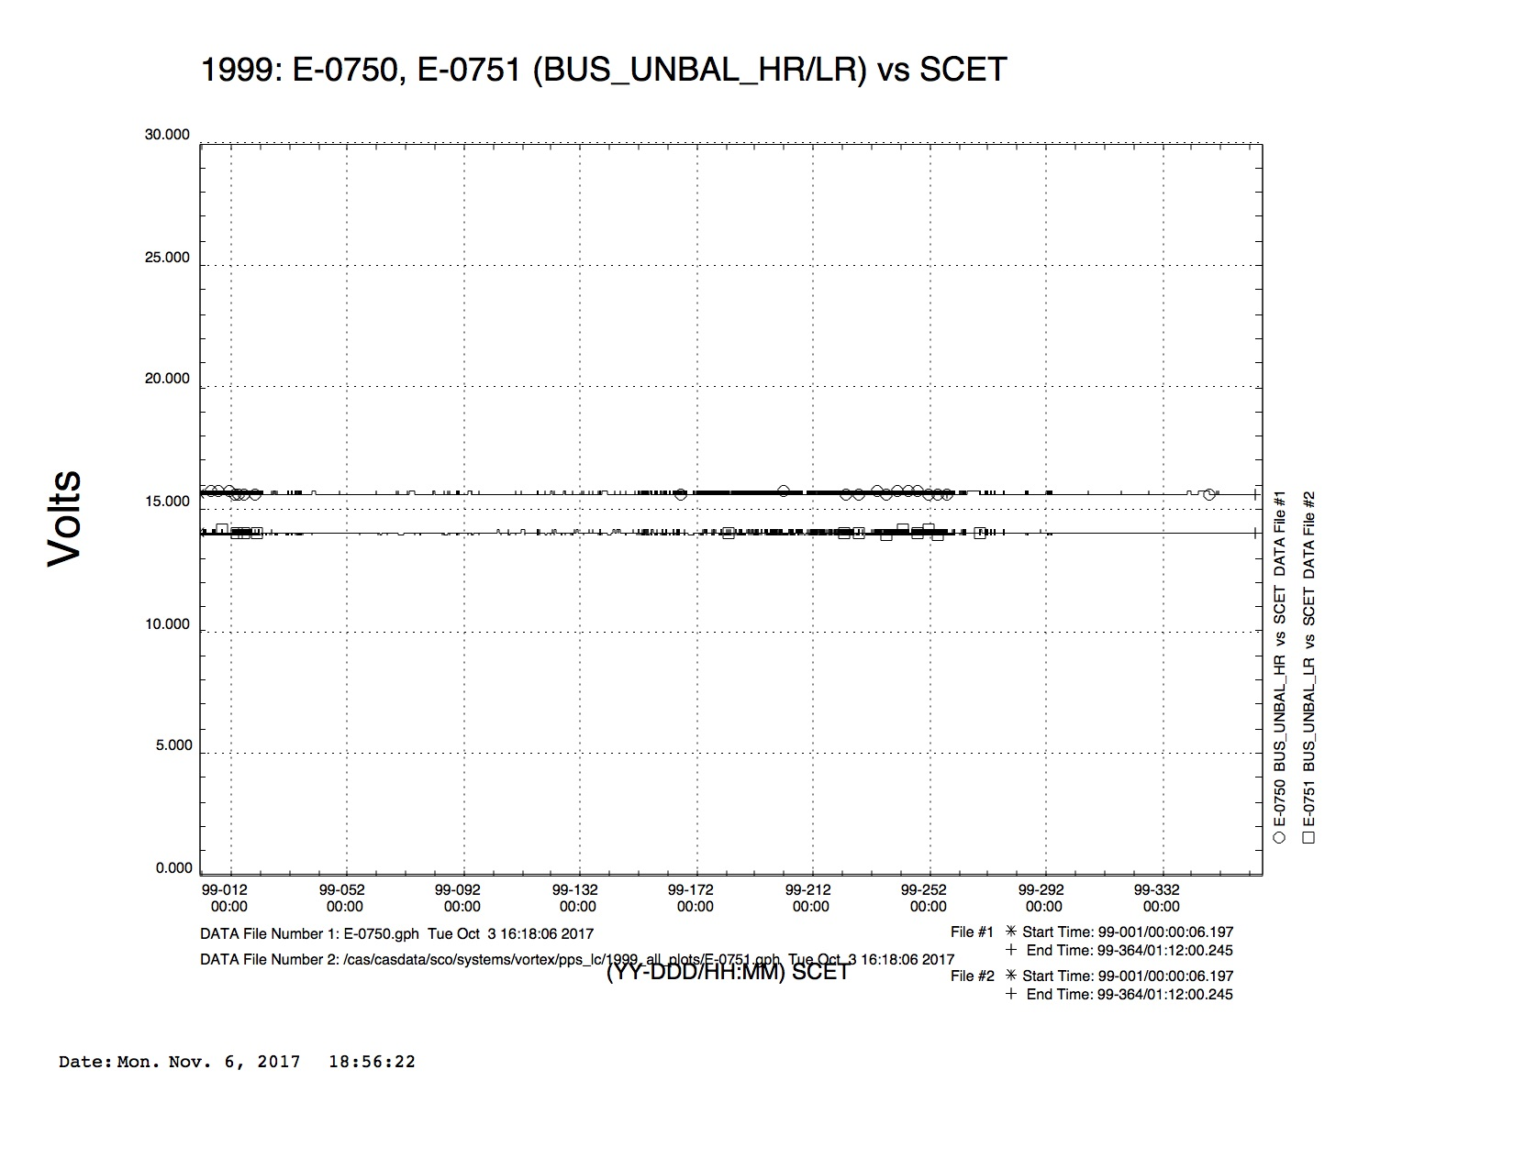
1999

Slide 5
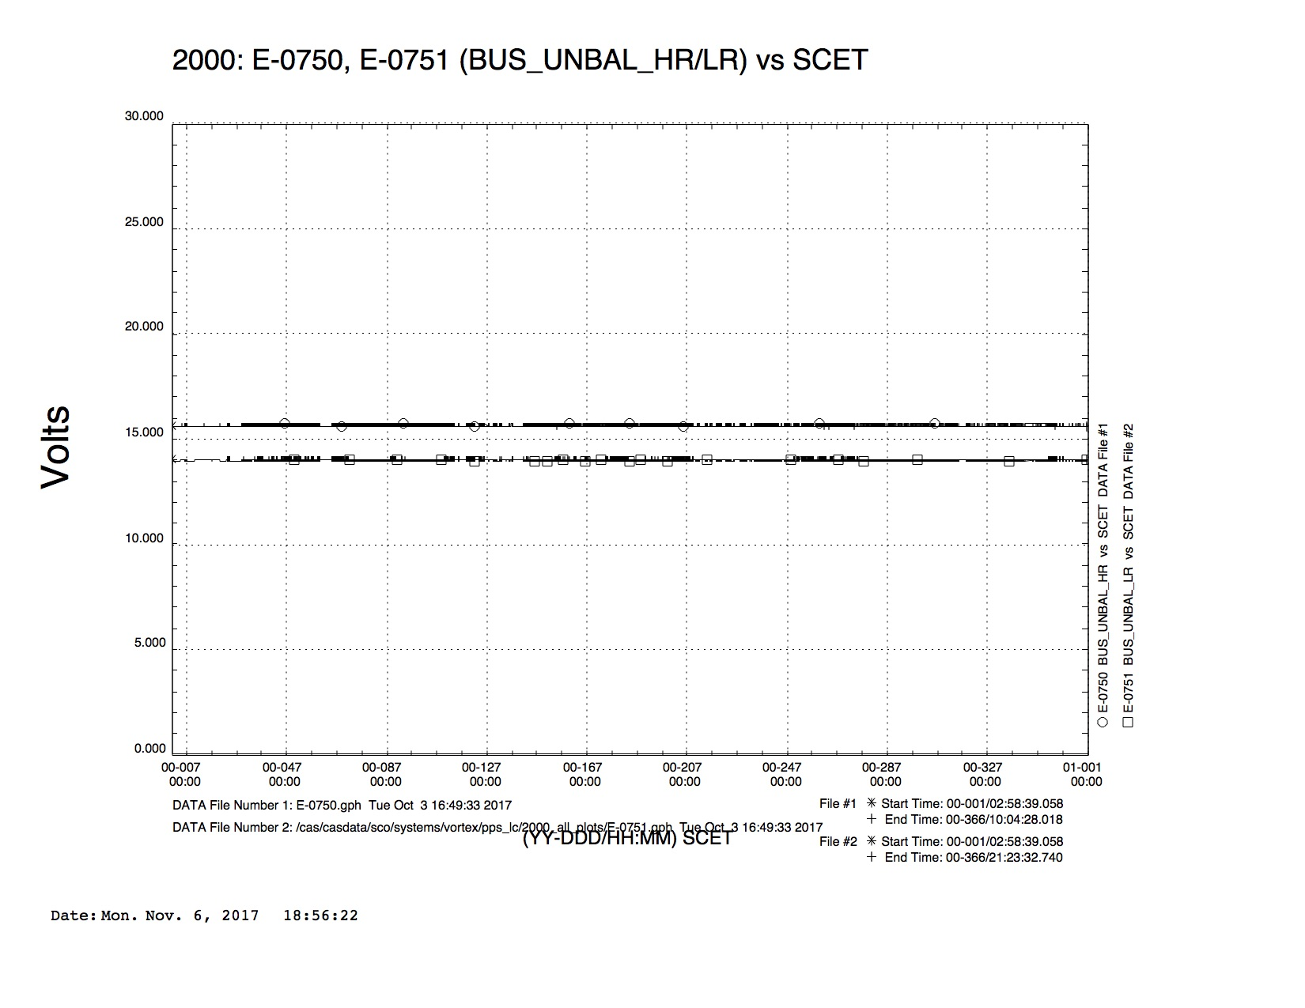
2000

Slide 6
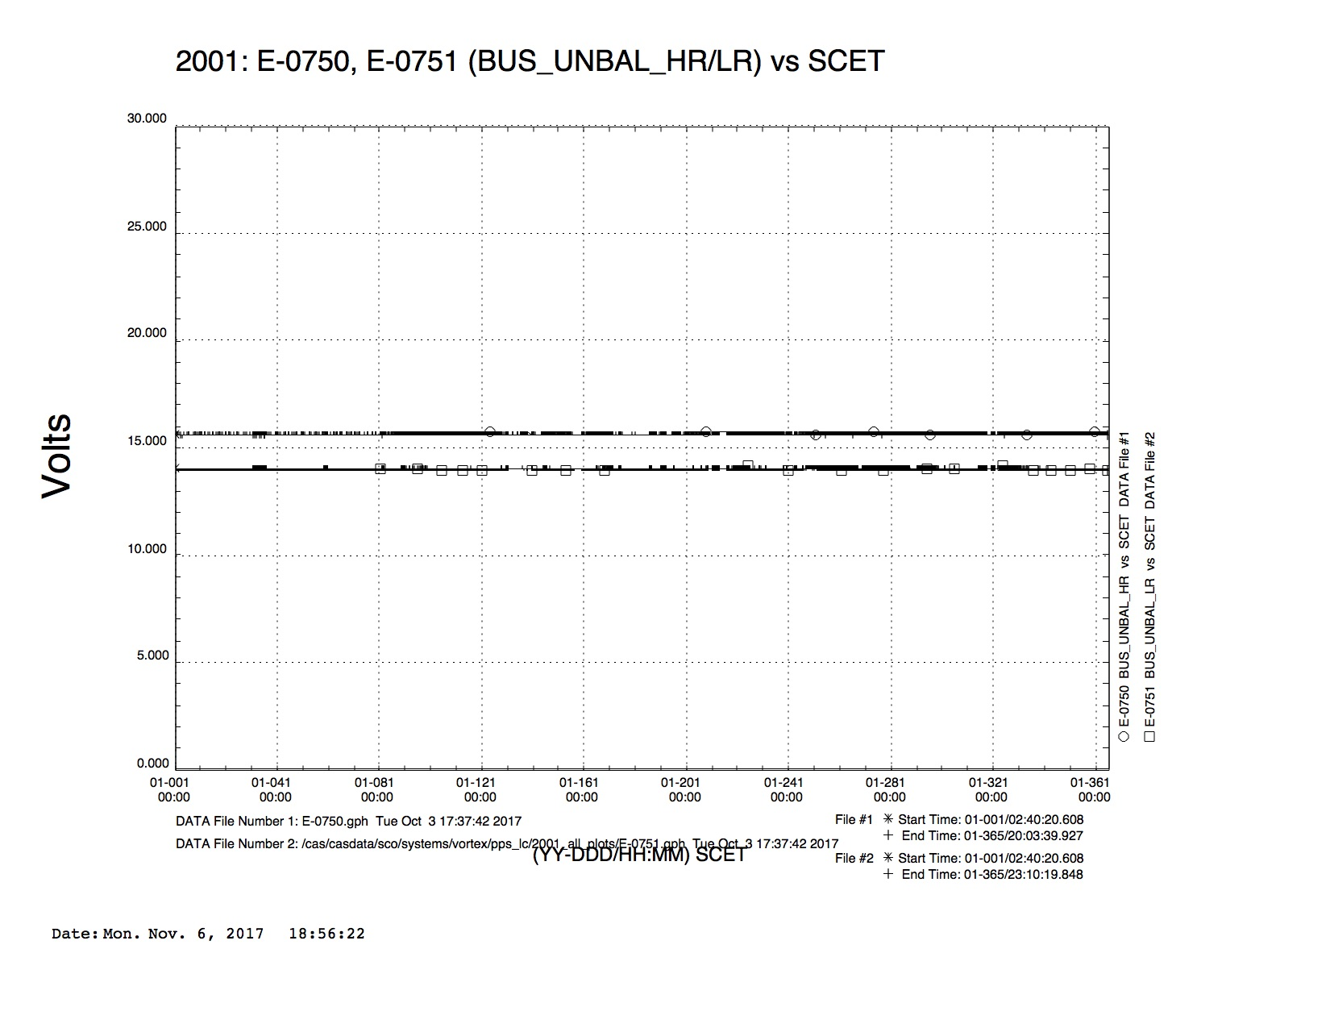
2001

Slide 7
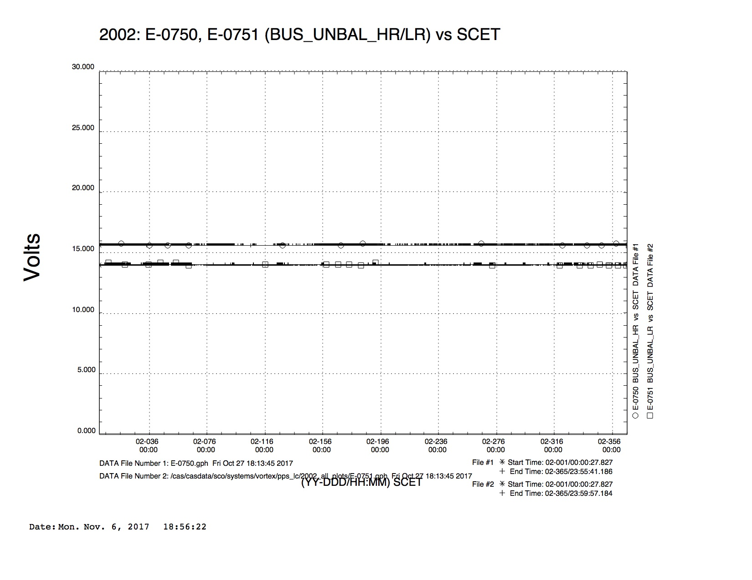
2002

Slide 8
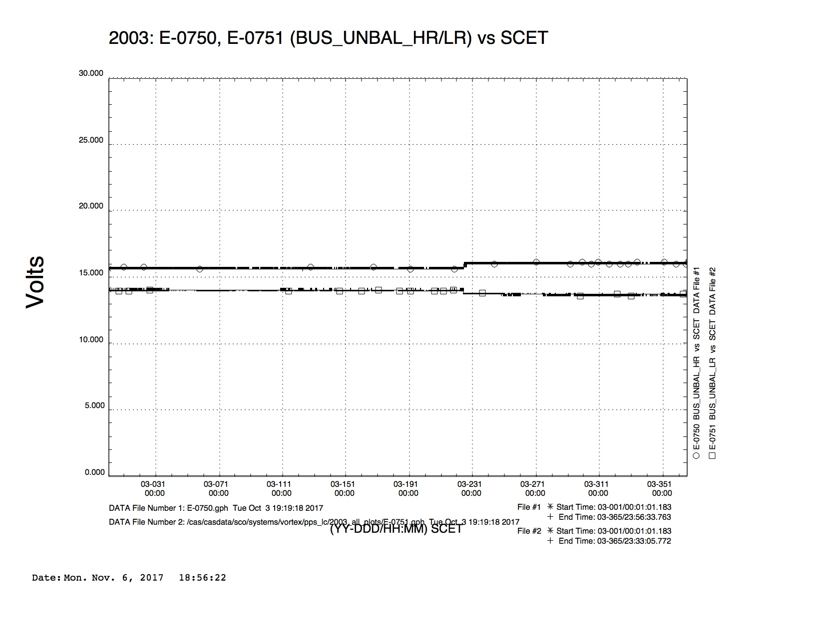
2003
2003-225

Slide 9
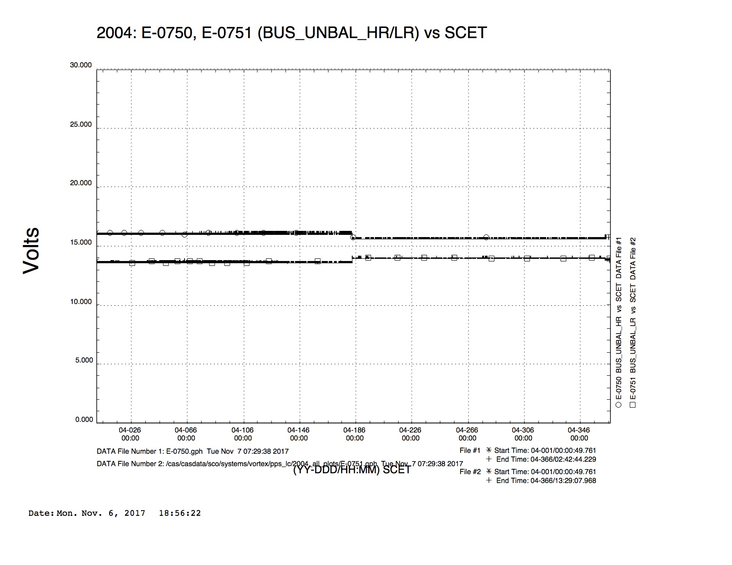
2004
2004-183
2004-363

Slide 10
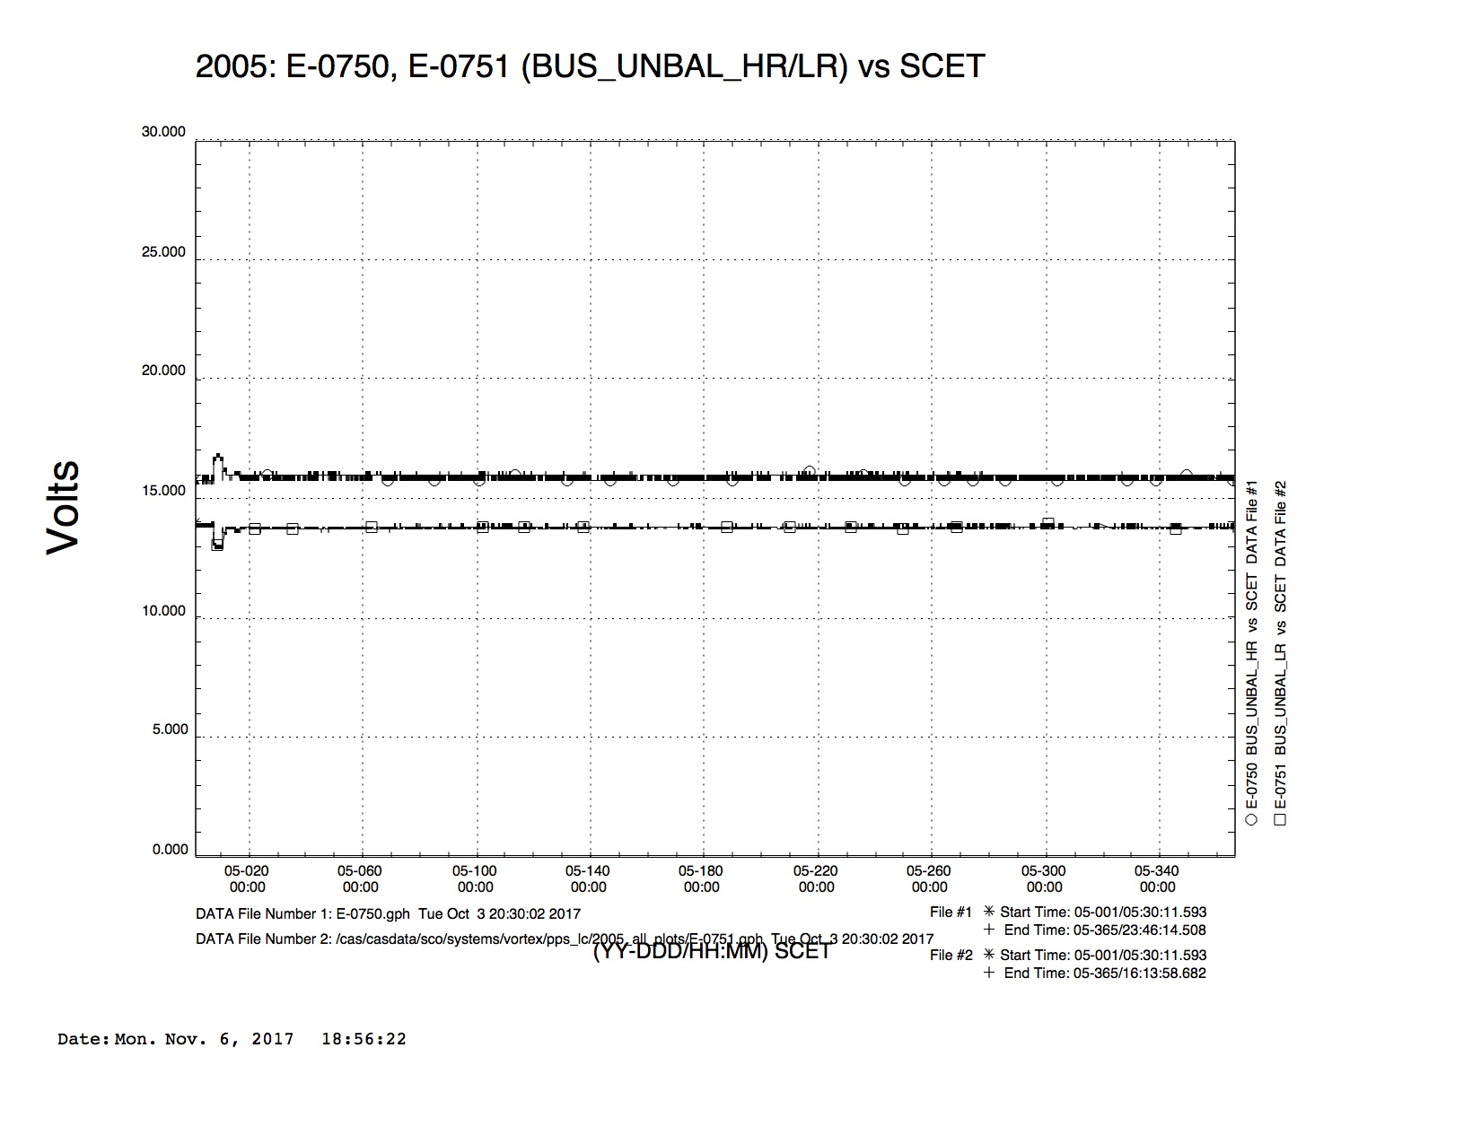
2005
2005-007, 010

Slide 11
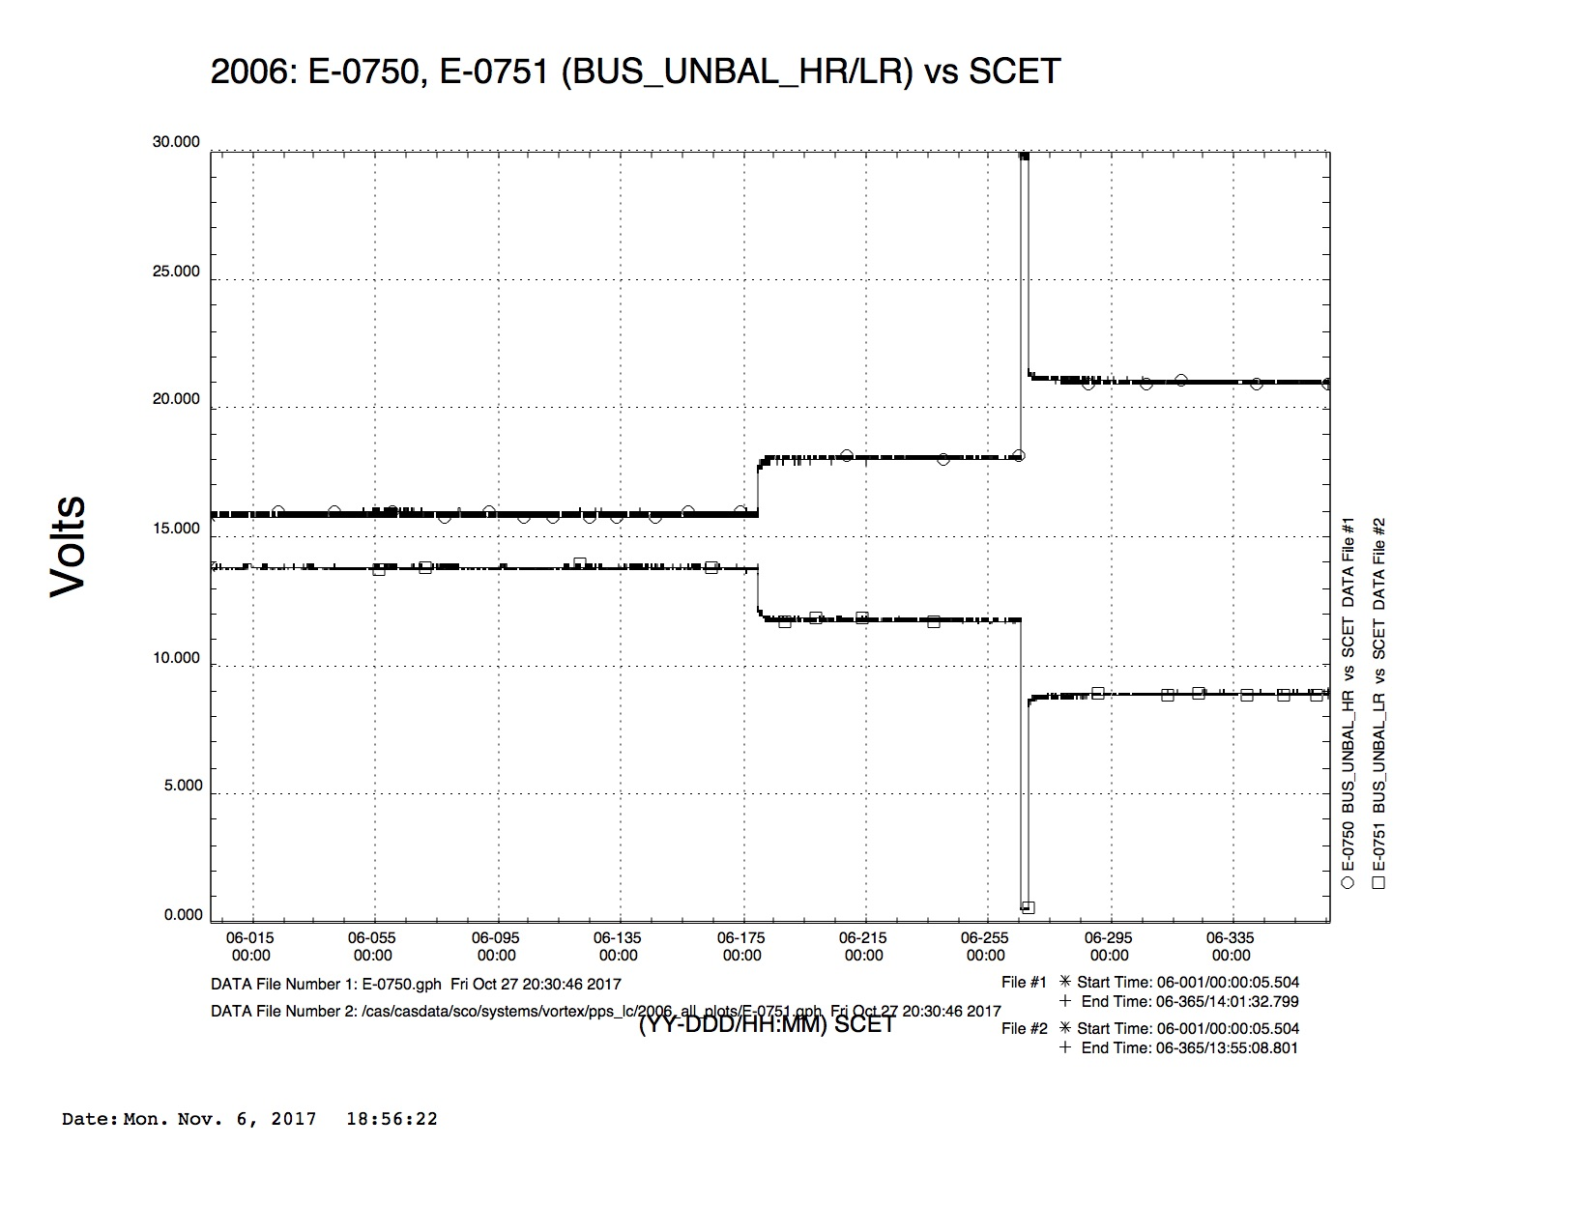
2006
2006-179, 265, 267

Slide 12
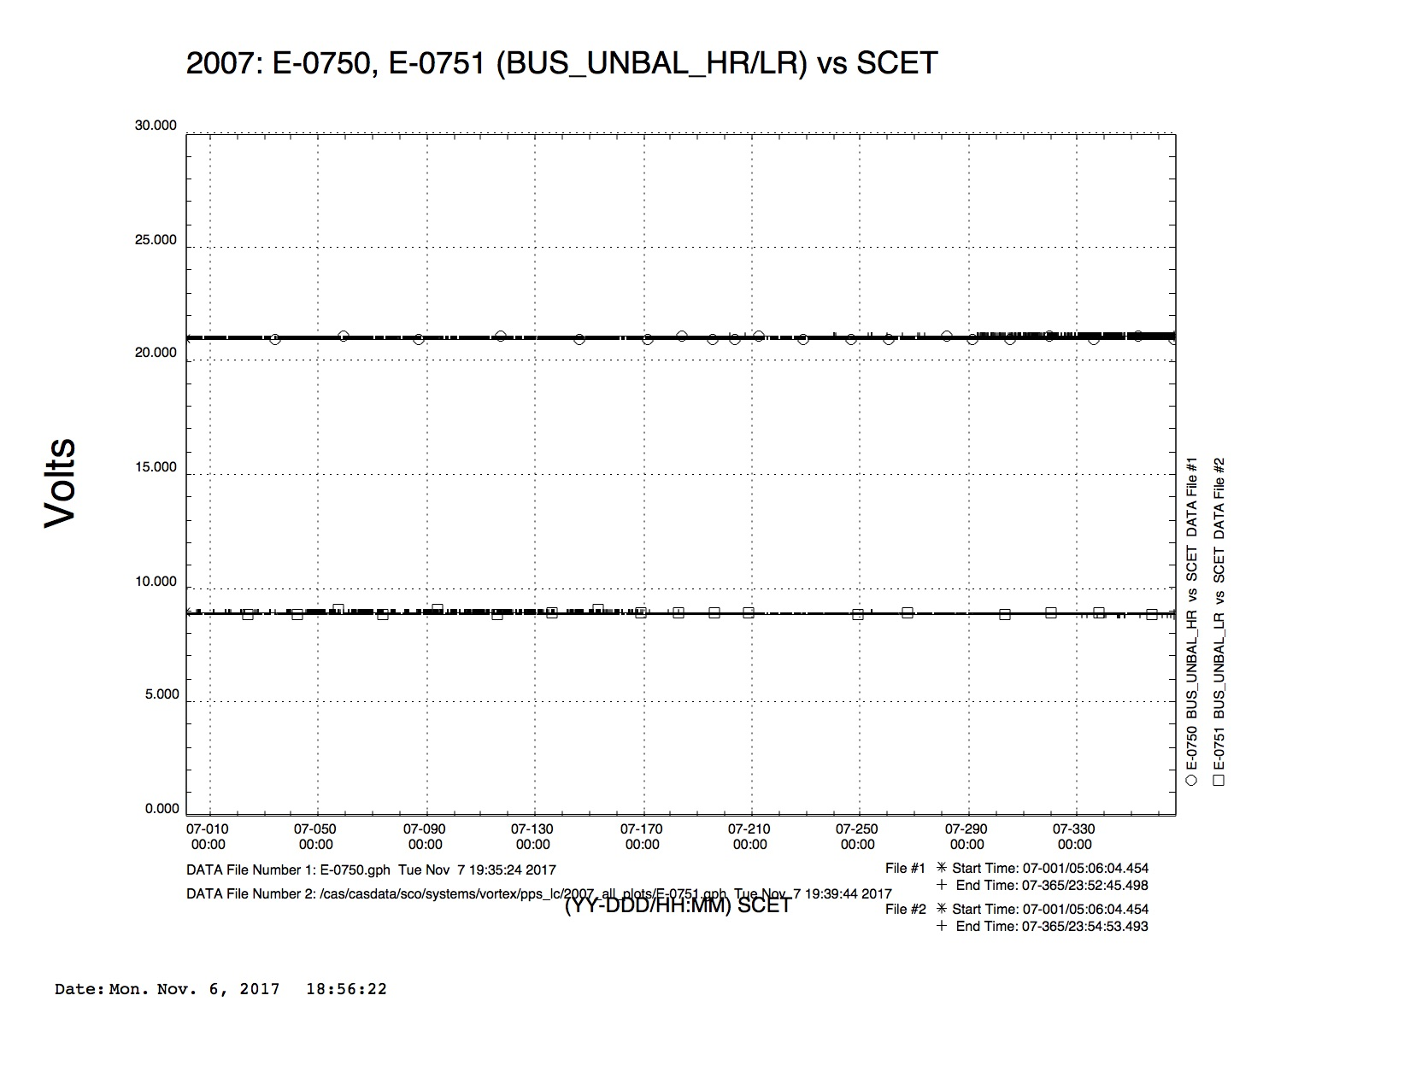
2007

Slide 13
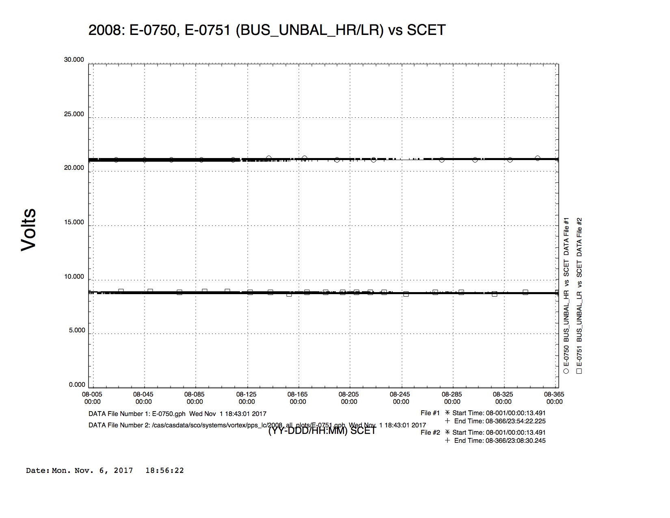
2008

Slide 14
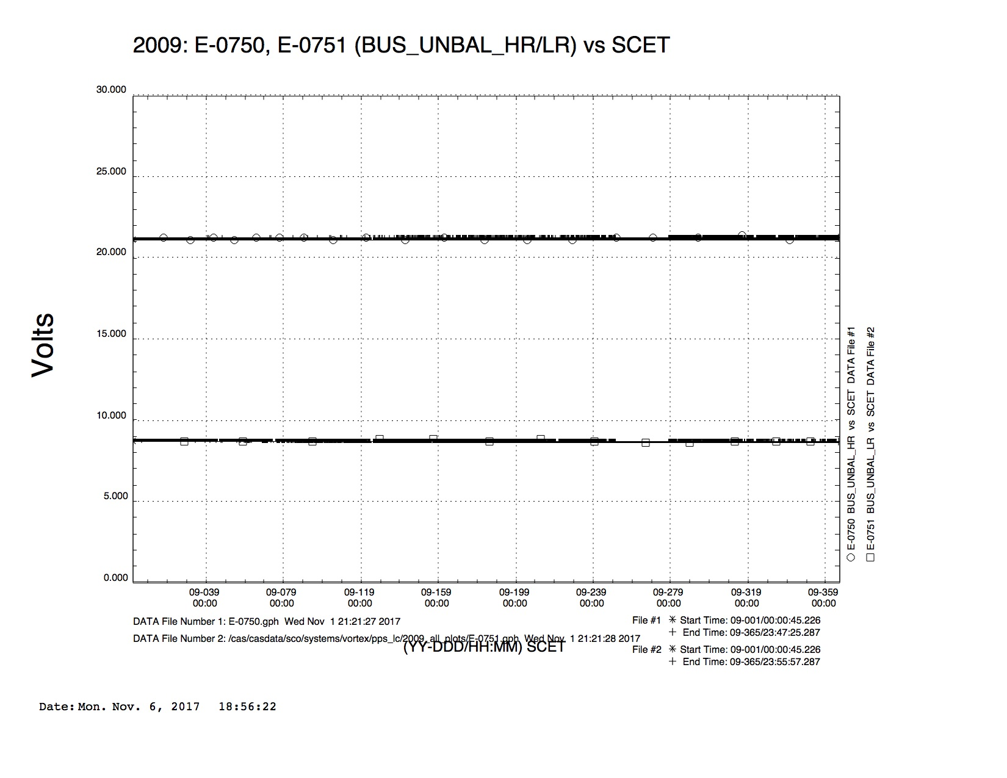
2009

Slide 15
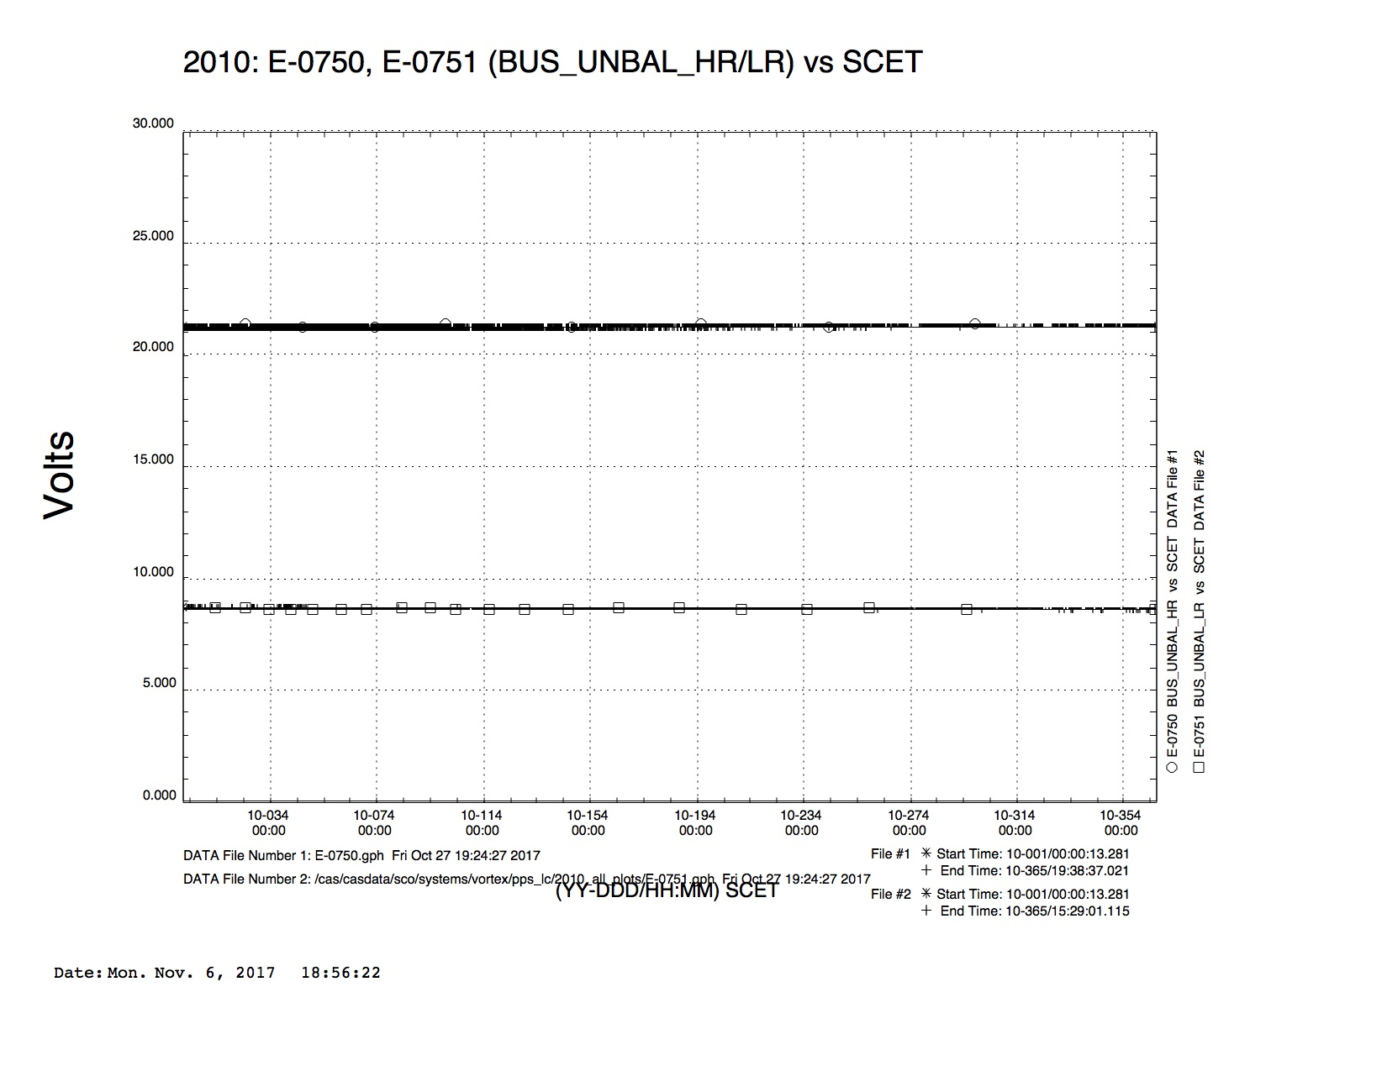
2010

Slide 16
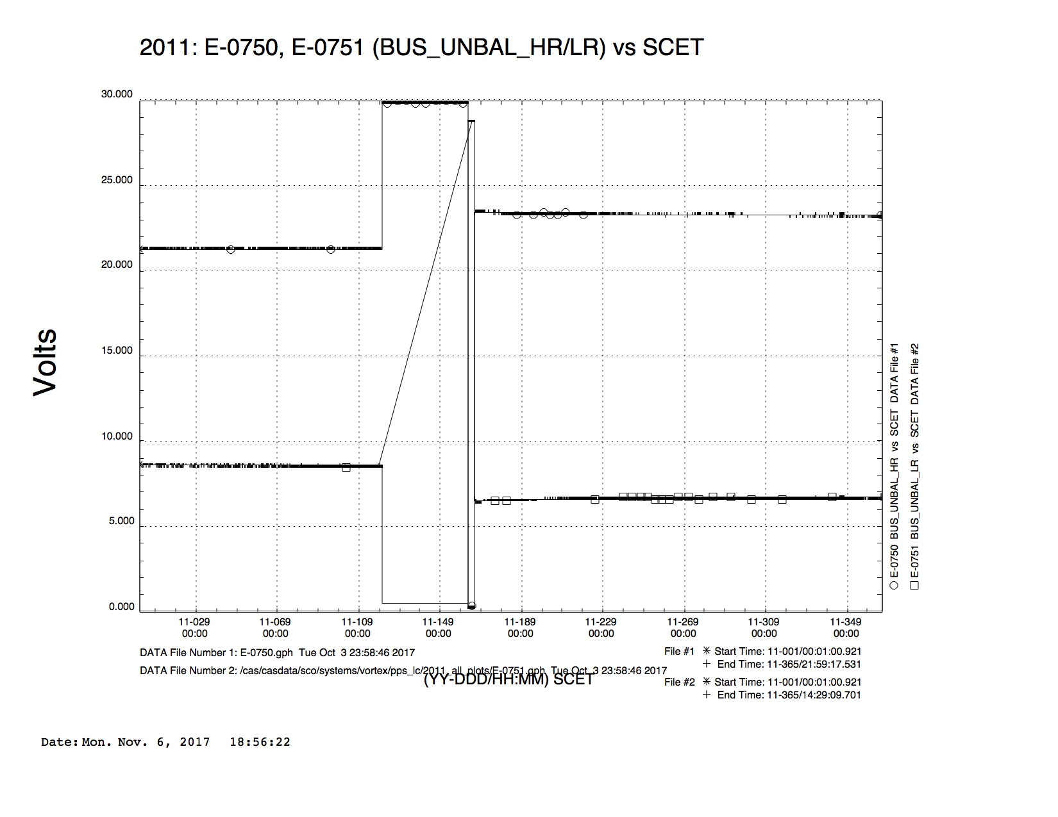
2011
2011-120, 162, 166

Slide 17
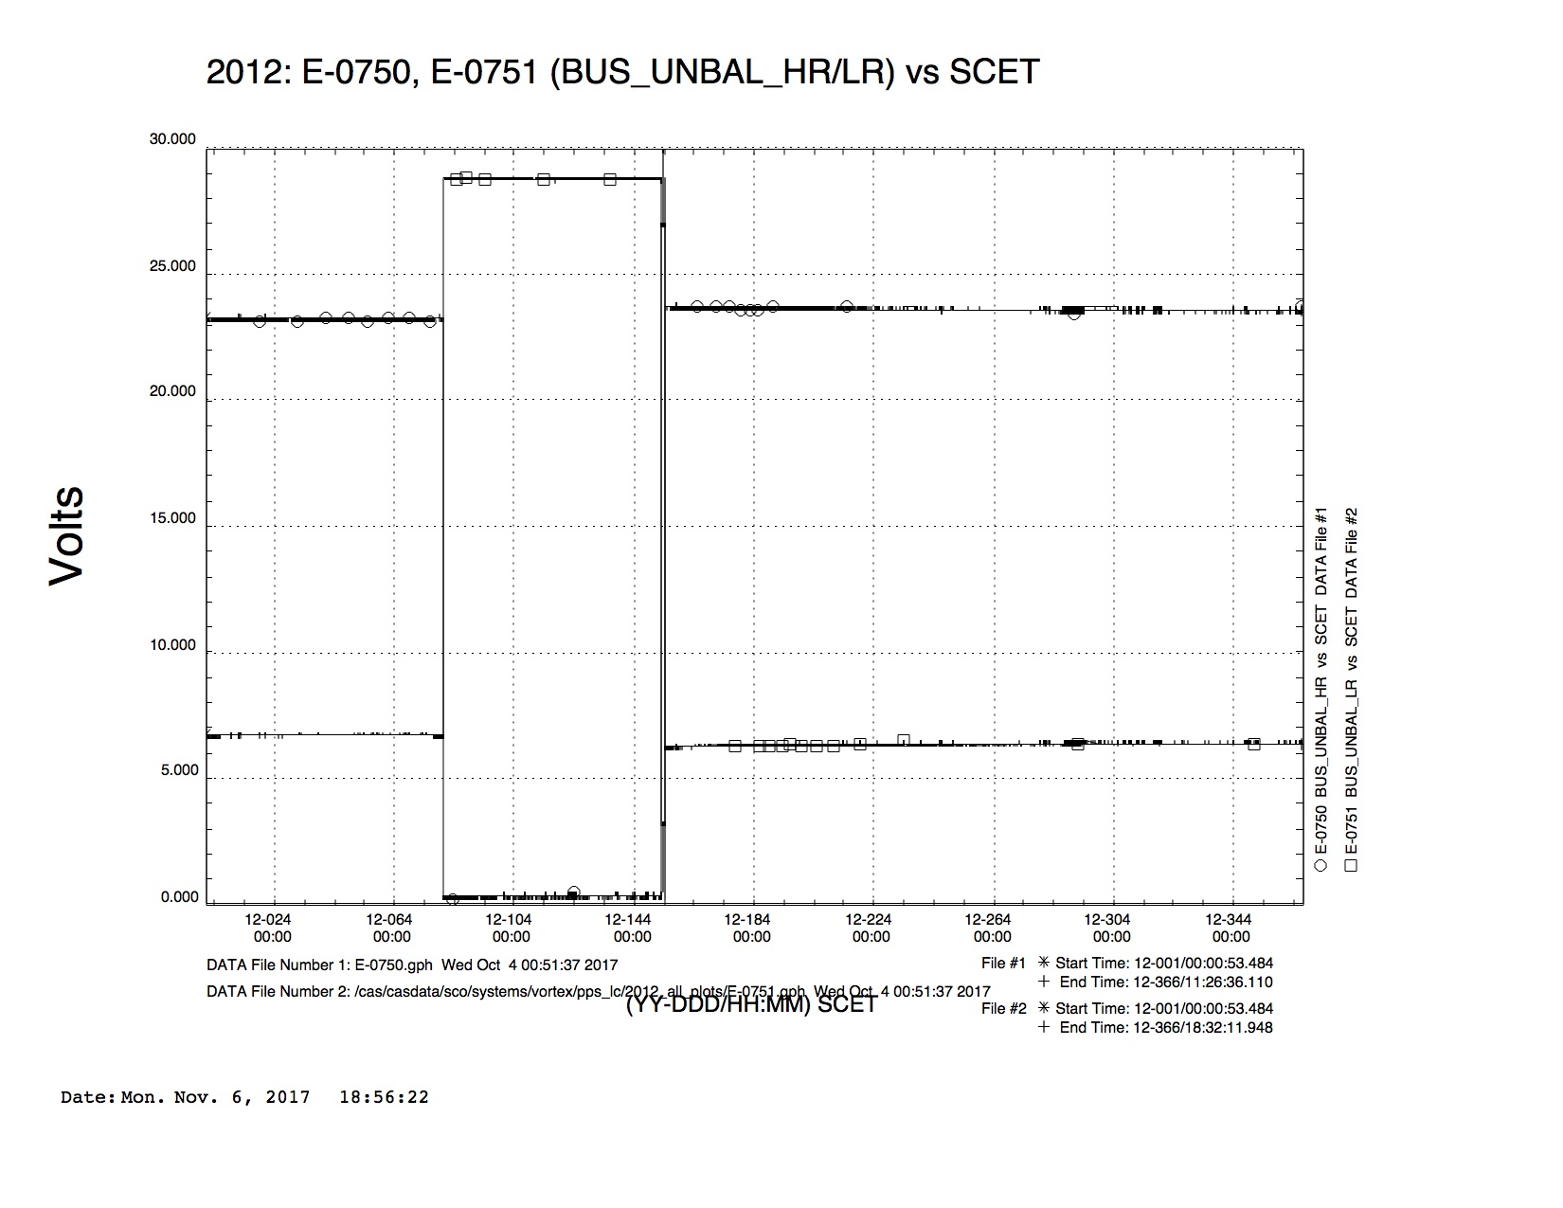
2012
2012-080, 153, 154

Slide 18
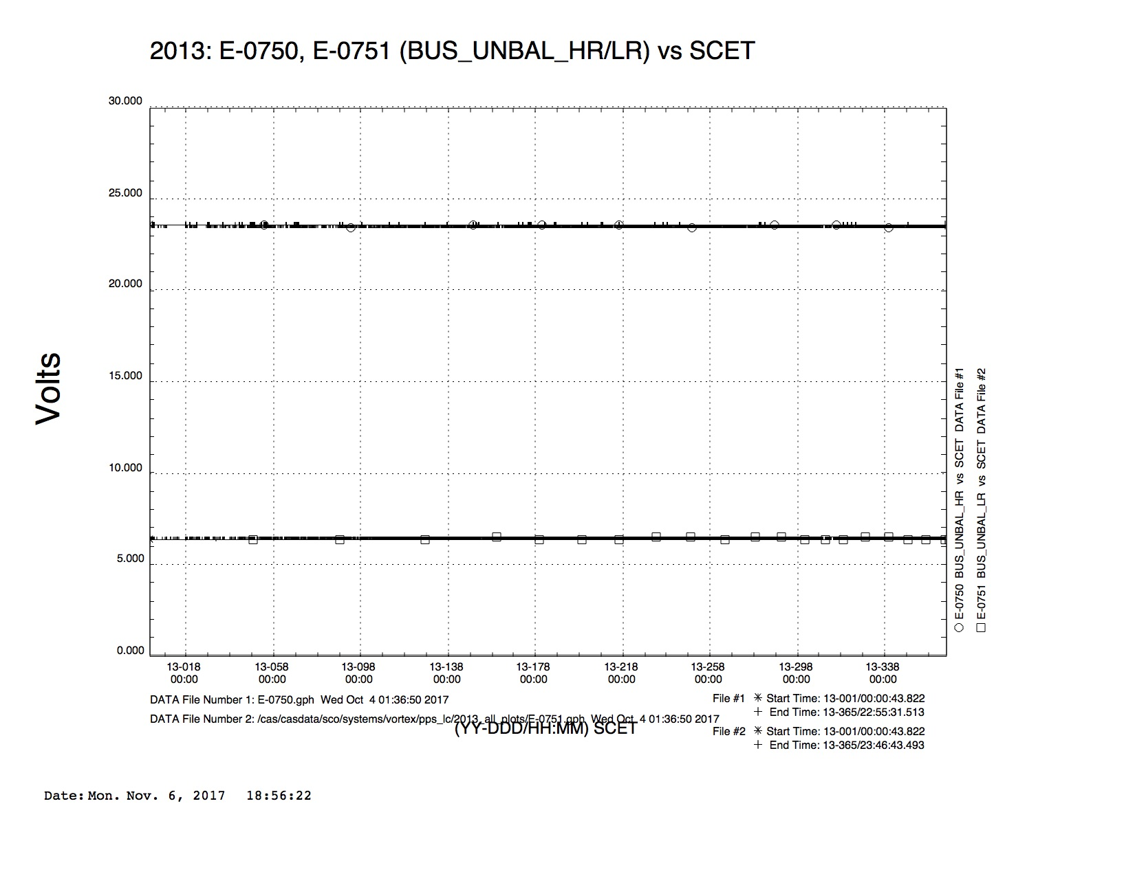
2013

Slide 19
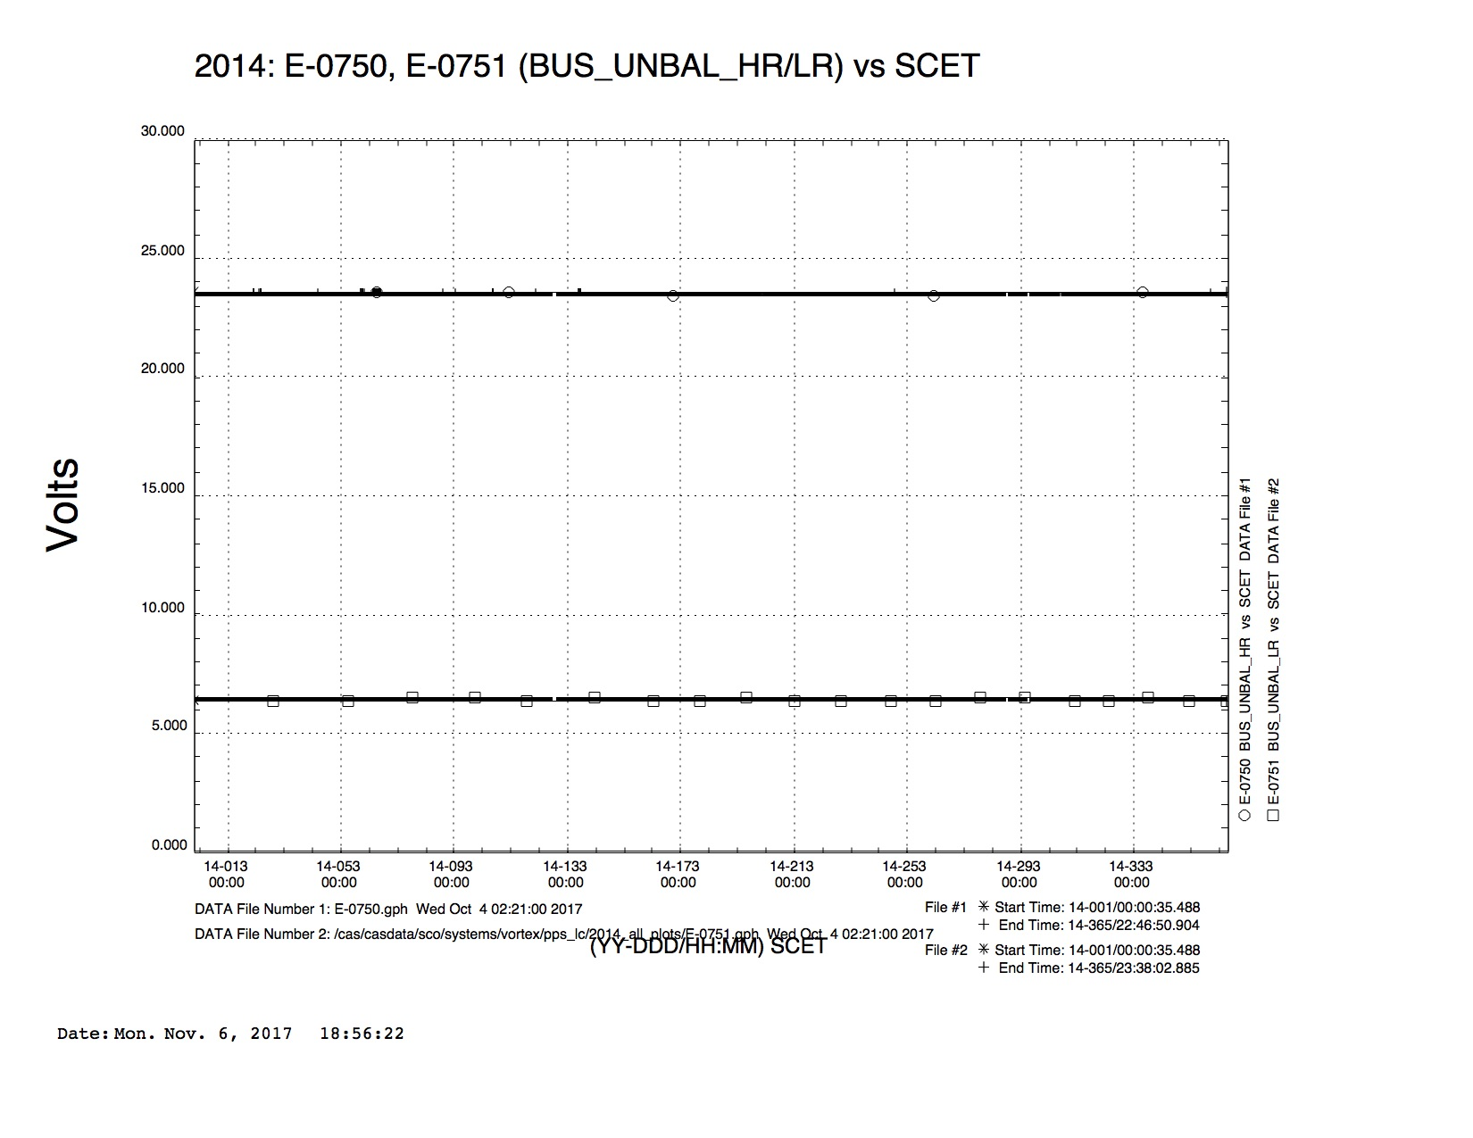
2014

Slide 20
2015

Slide 21
2016

Slide 22
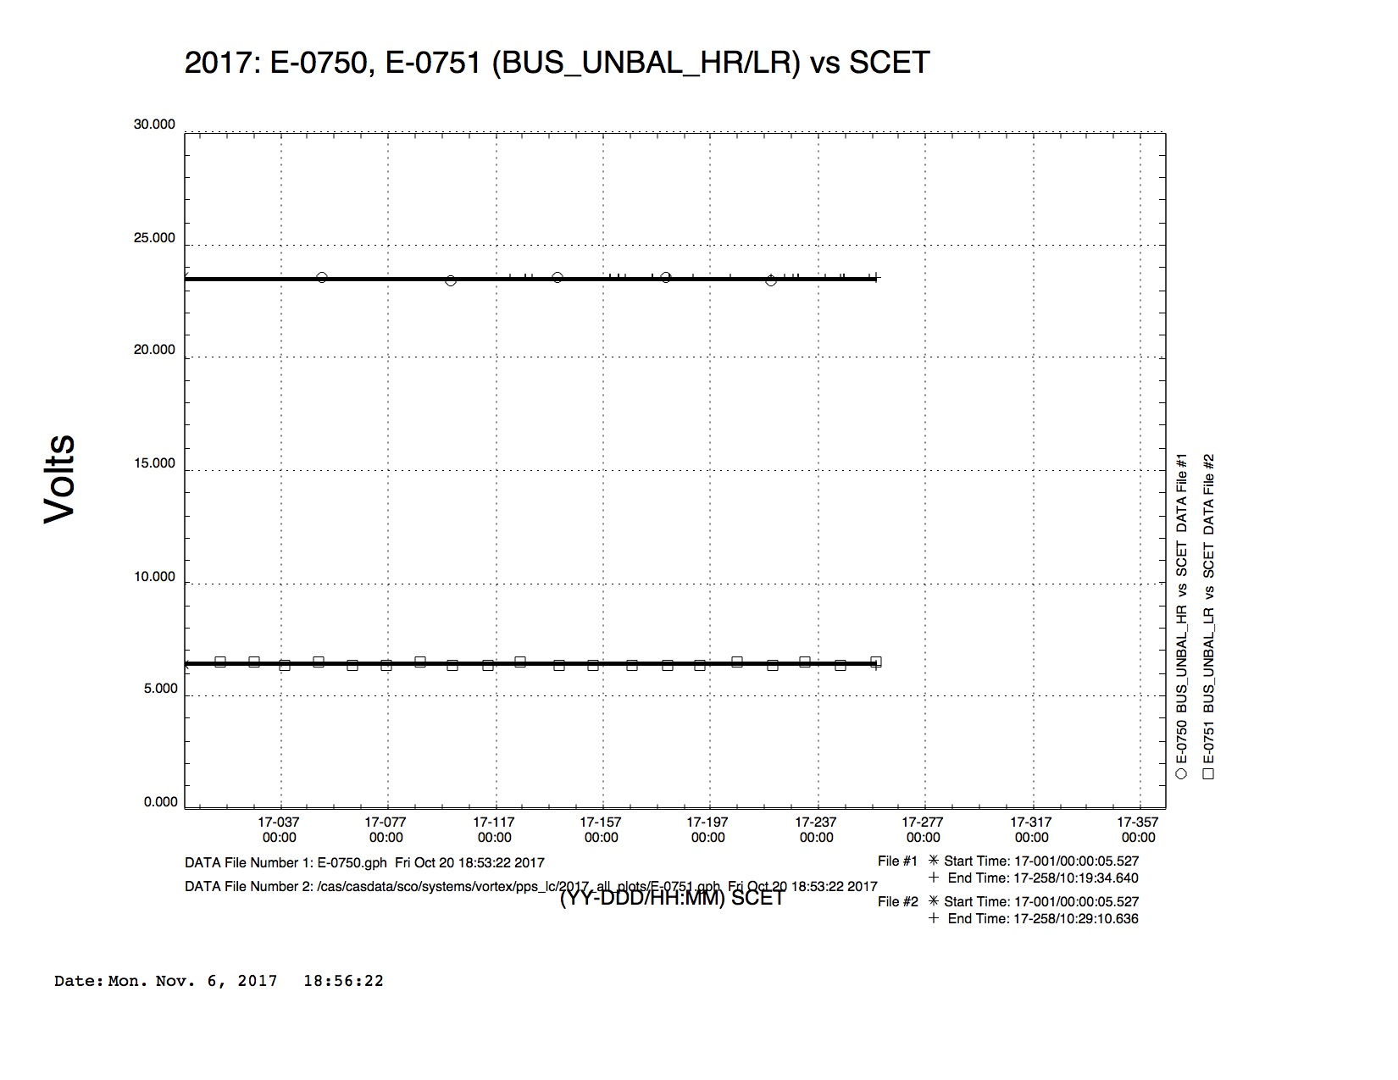
2017

Slide 23
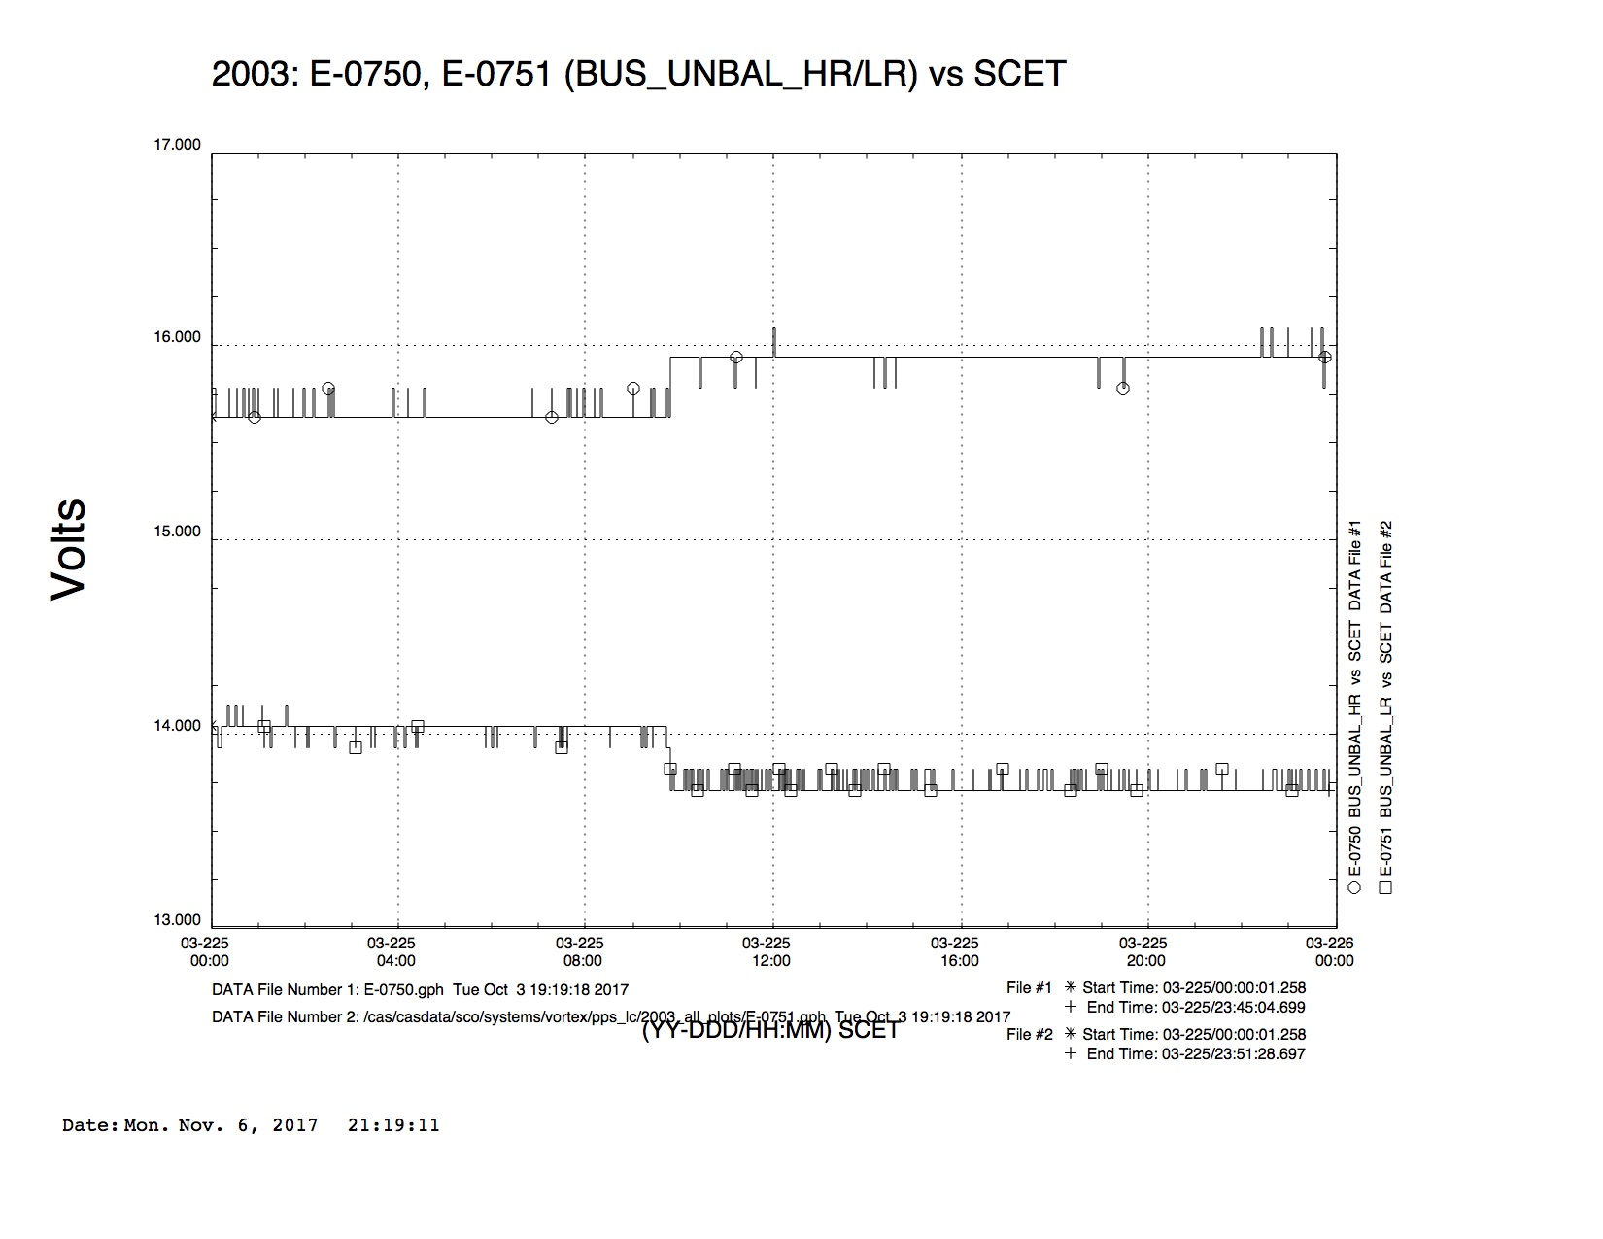
2003-225
high rail low rail
2003-225T09:46:41 15.63 13.93
2003-225T09:47:45 15.78 13.81

Slide 24
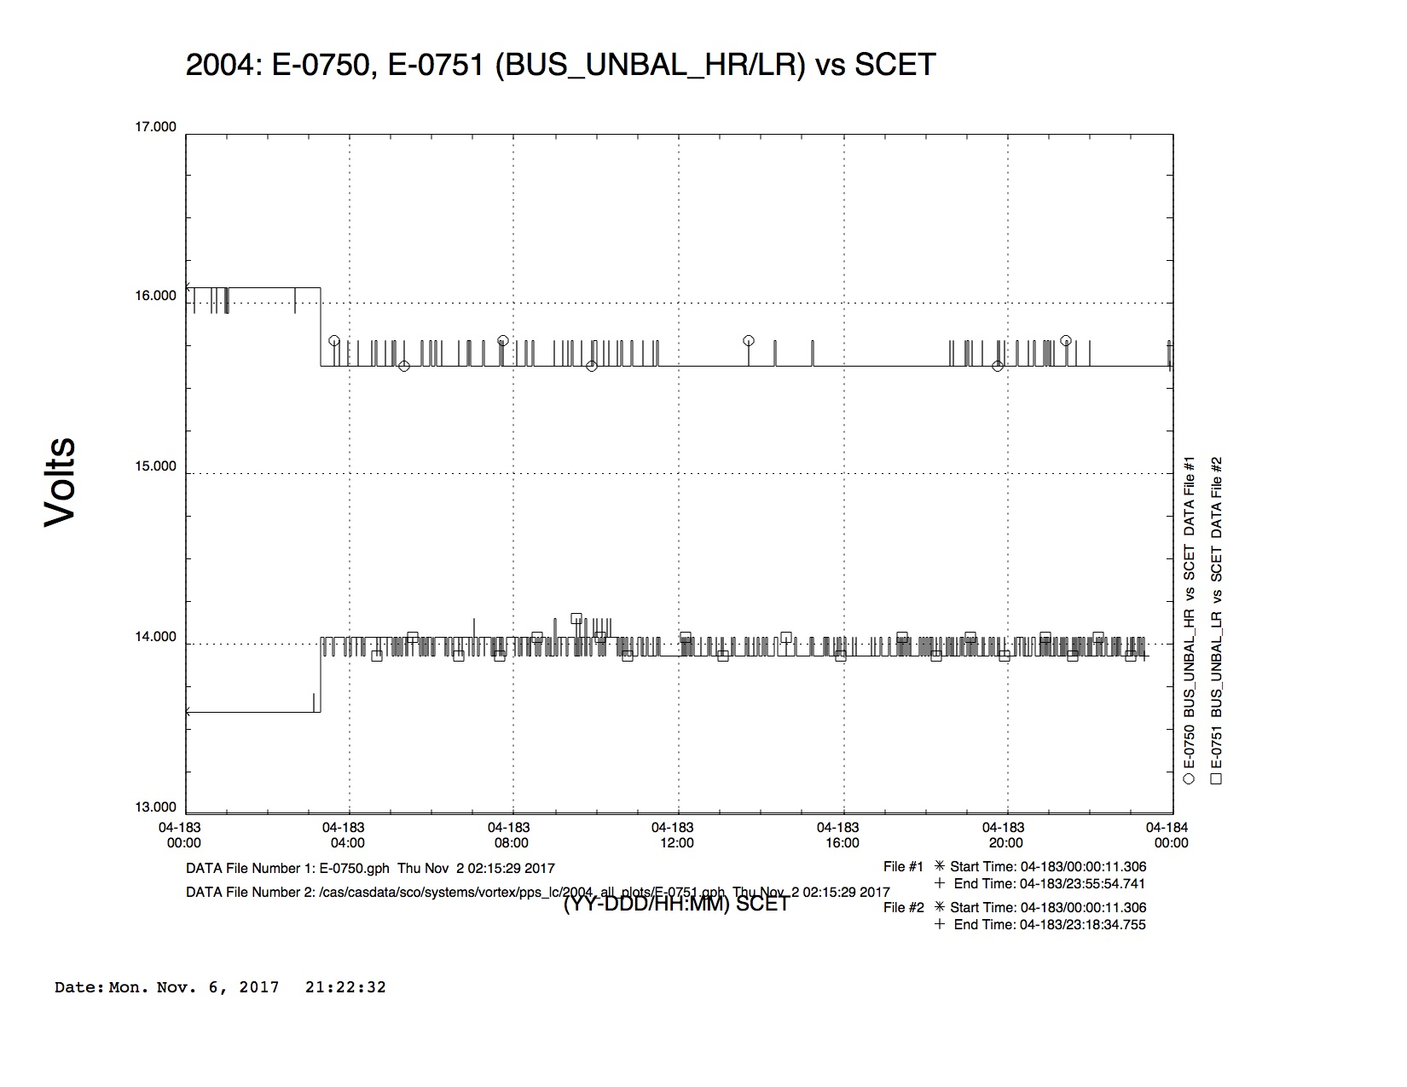
2004-183
high rail low rail
2004-183T03:05:35 16.10 13.59
2004-183T03:18:35 15.63 14.04

Slide 25
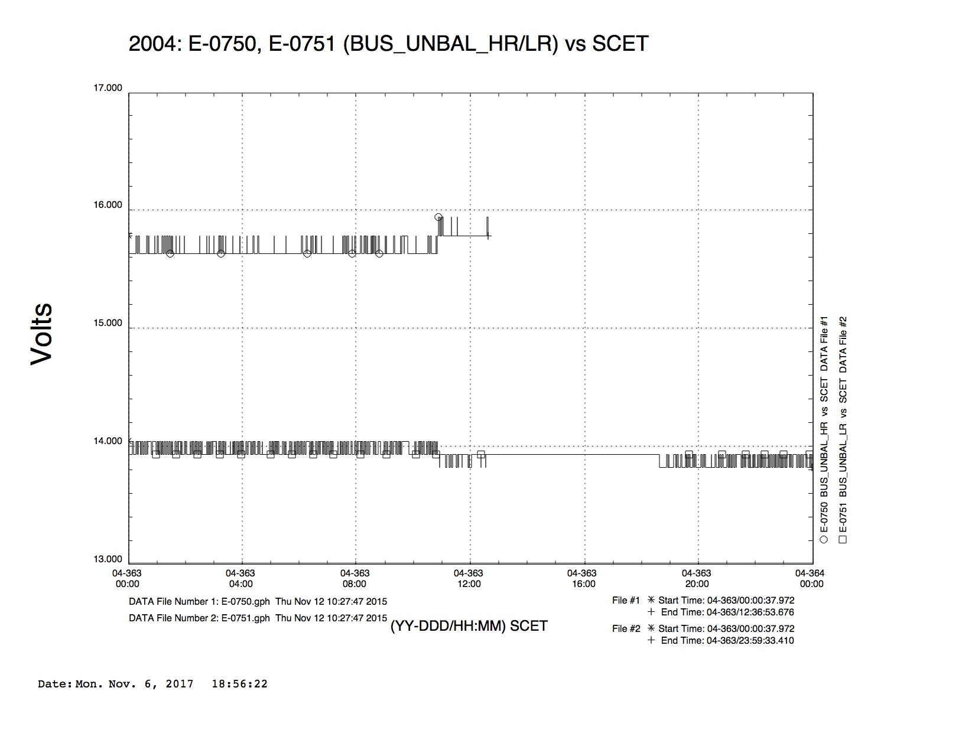
2004-363
high rail low rail
2004-363T10:51:17 15.78 13.93
2004-363T10:53:25 15.94
2004-363T10:54:29 13.81

Slide 26
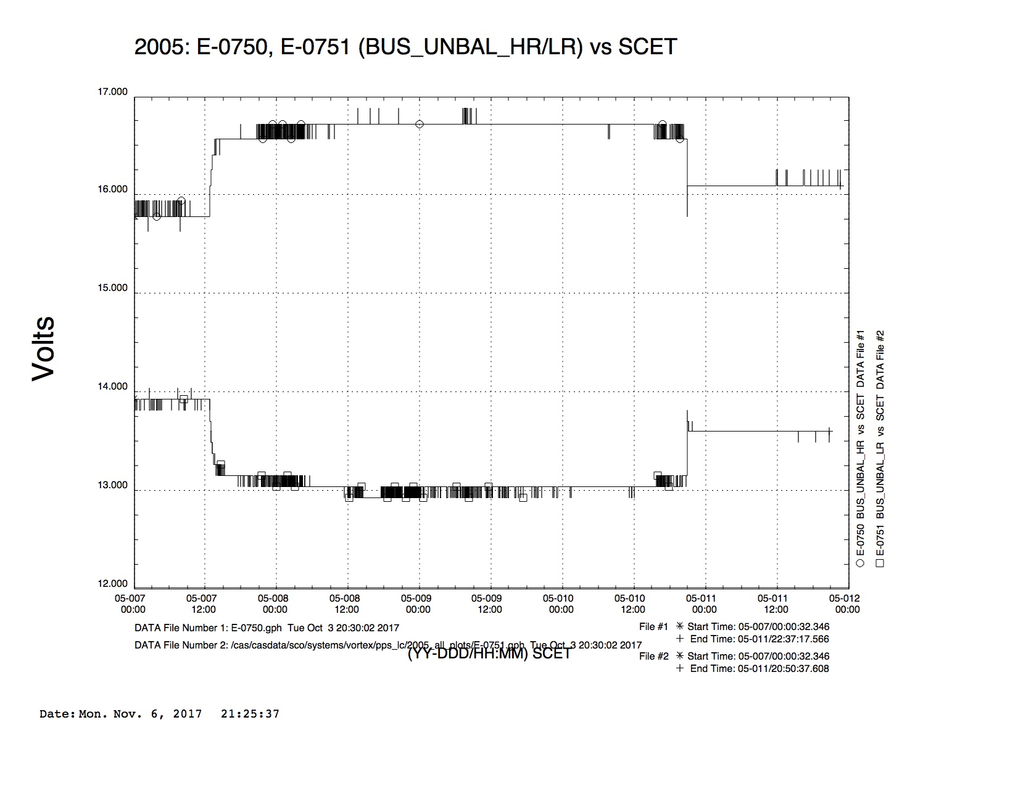
2005-007
high rail low rail
2005-007T12:44:16 15.78 13.93
2005-007T12:50:40 16.10 13.70
high rail low rail
2005-010T20:54:54 16.41 13.37
2005-010T20:55:58 15.93 13.81

Slide 27
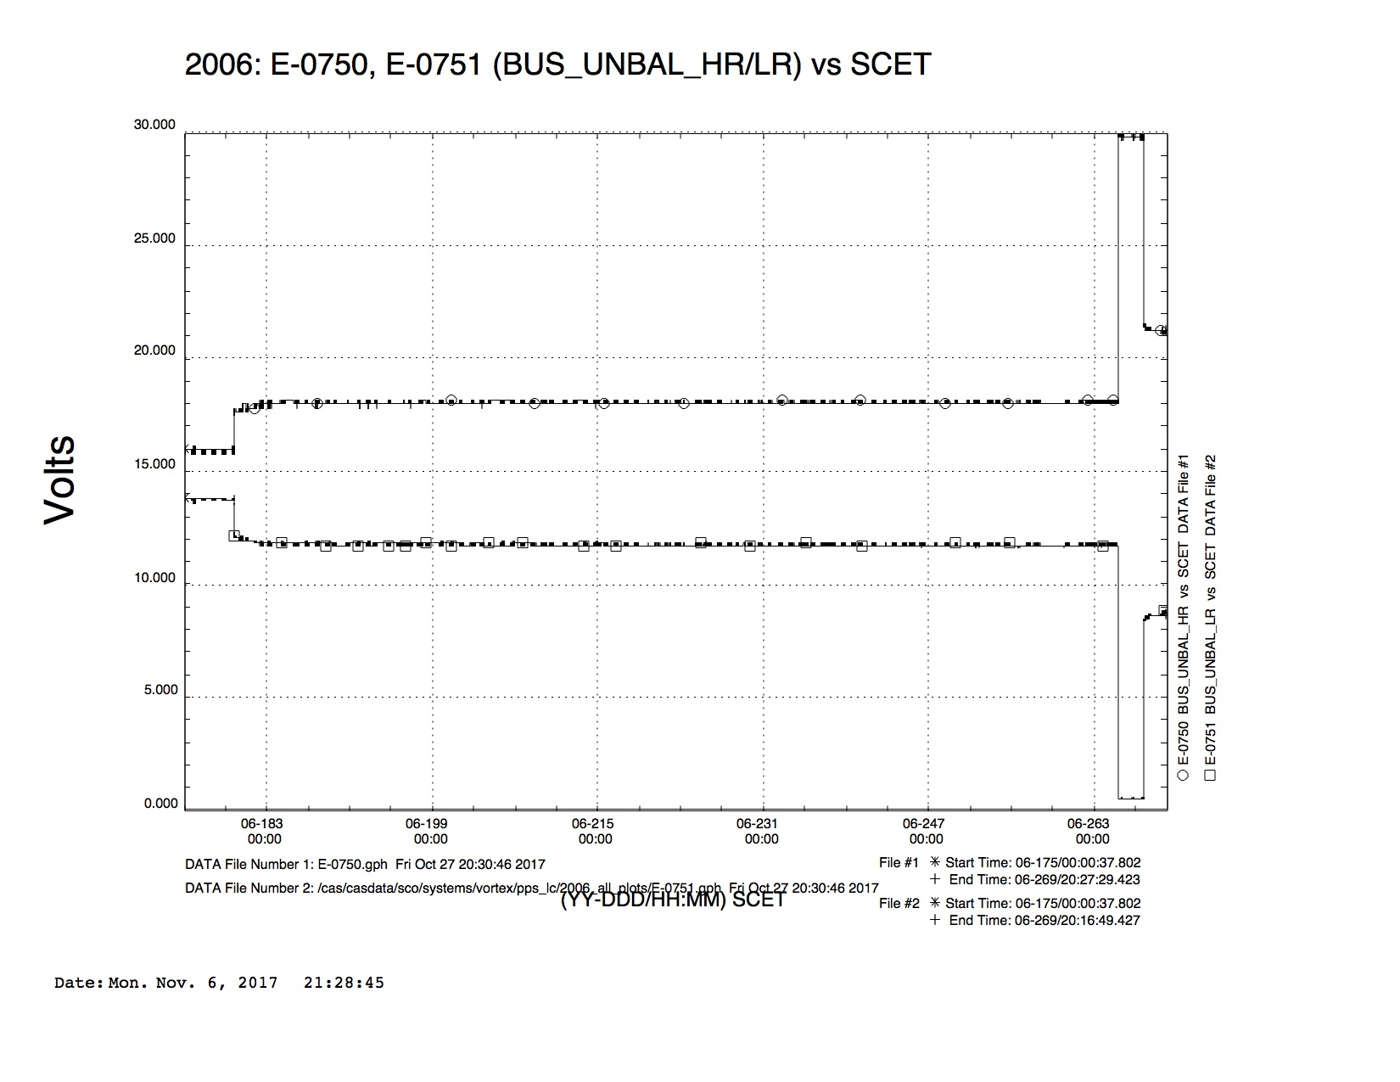
2006-179
high rail low rail
2006-265T07:48:03 17.97 11.70
2006-265T08:00:51 30.00 0.46
high rail low rail
2006-179T19:33:55 16.10 13.59
2006-179T19:34:59 16.56 13.15
high rail low rail
2006-267T19:49:06 29.69 0.46
2006-267T19:50:10 21.56 8.36

Slide 28
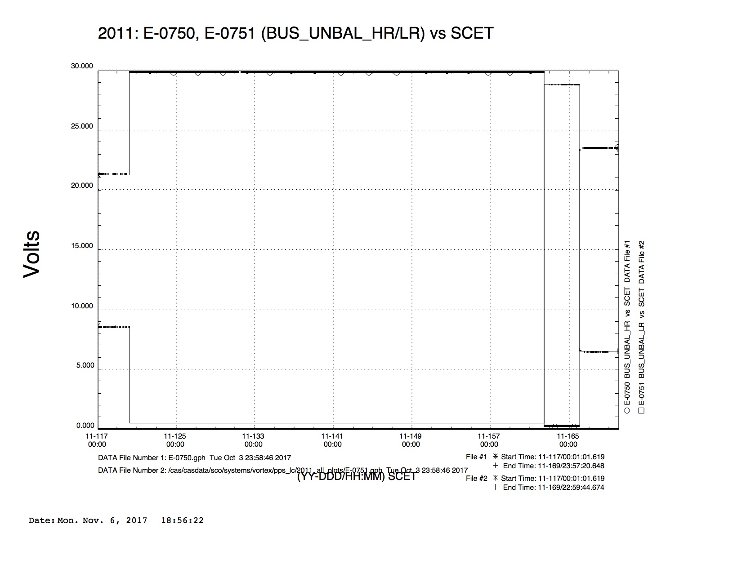
2011-120
high rail low rail
2011-120T06:08:59 21.25 8.59
2011-120T06:15:23 30.00 0.46
high rail low rail
2011-162T11:22:12 30.00 0.46
2011-162T11:23:16 0.16 28.84
2011-166T00:45:22 0.32 28.84
2011-166T00:49:38 23.13 6.69

Slide 29
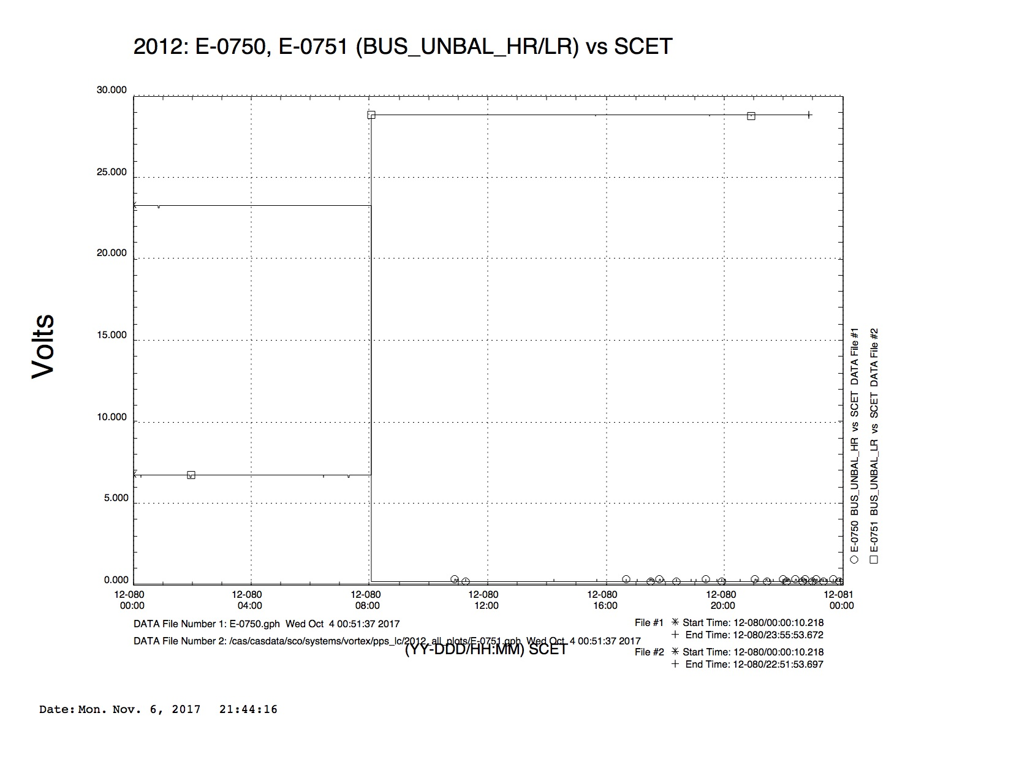
2012-080
high rail low rail
2012-080T07:18:34 23.28 0.69
2012-080T08:04:26 0.16 28.84

Slide 30
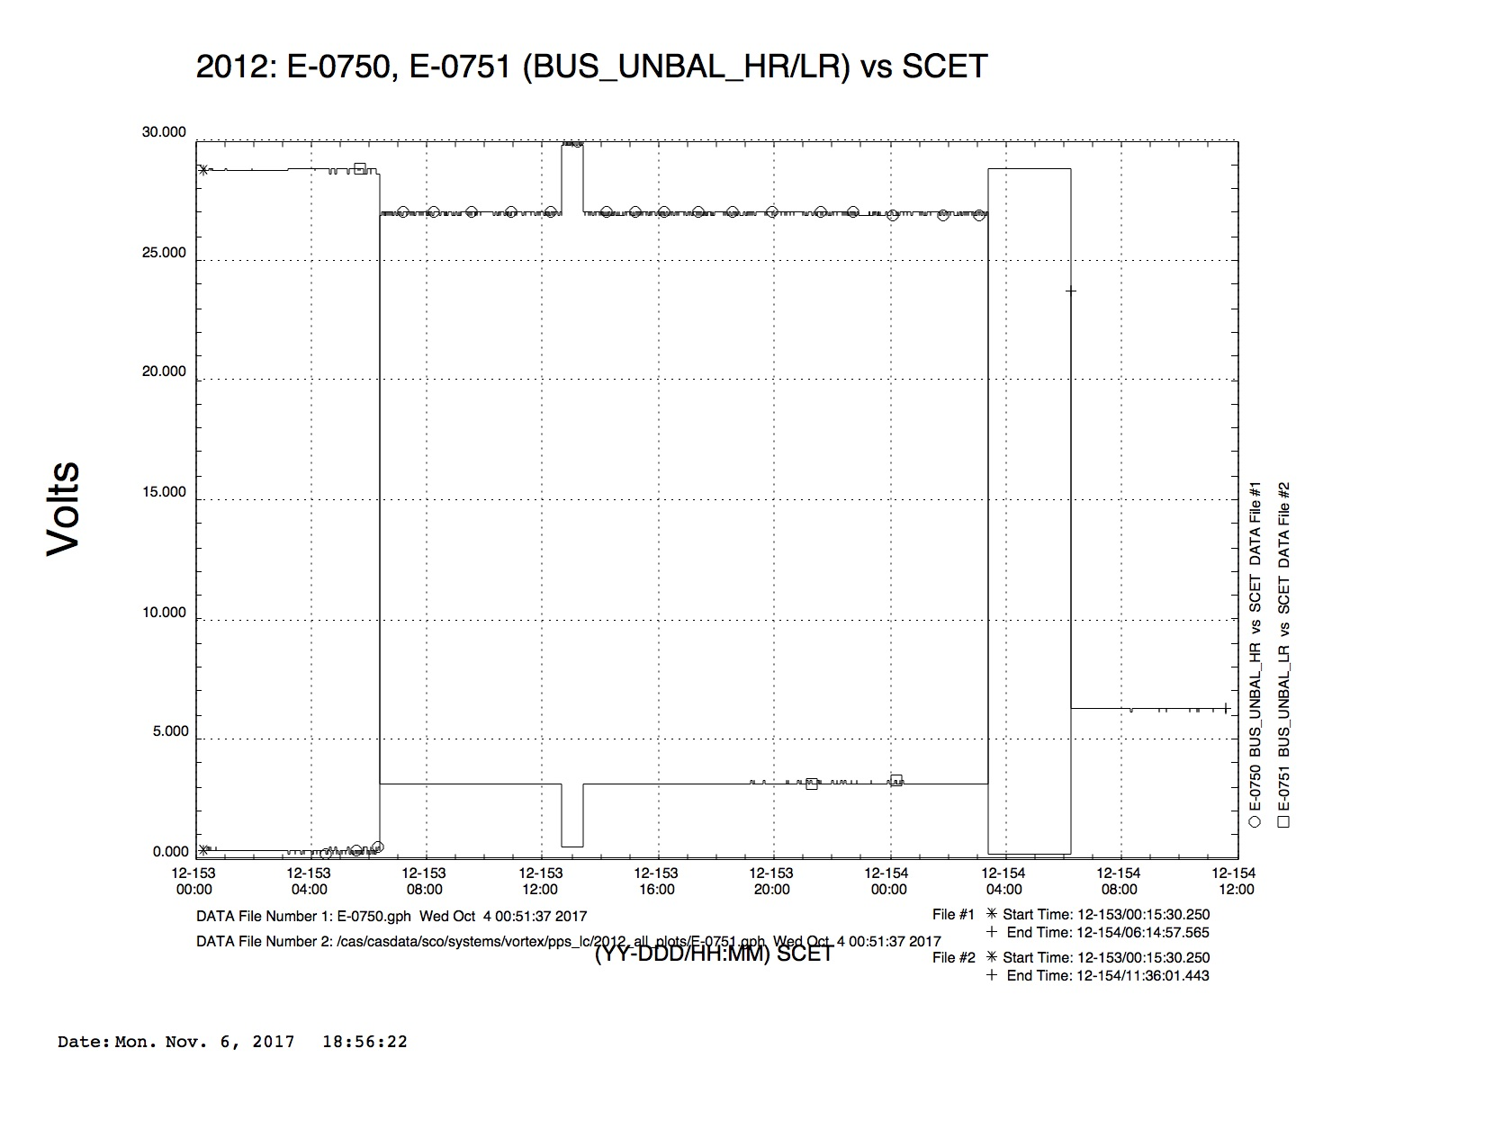
2012-153
high rail low rail
2012-153T06:22:26 0.48 28.61
2012-153T06:23:30 26.87 3.13
2012-153T12:38:57 27.03 3.13
2012-153T12:40:01 29.84 0.46
2012-153T13:19.29 29.94 0.46
2012-153T13:22:41 27.03 3.13
High rail low rail
2012-154T03:21:05 27.03 3.13
2012-154T03:23:13 0.16 28.84
2012-154T06:13:53 23.59 9.25

